Slide 1
Web Audio Visualizer
Team Codescapes
(Miguel Vazquez and Luc Tang)

Slide 2
What is an Audio Visualizer?
Audio visualization consists of a software that generates animated imagery based on a piece of audio.
This imagery is usually generated and rendered in real time and it is synchronized with the audio being played.

Slide 3
Goal
Website where the users can upload or select an audio file to generate reactive visuals.

Slide 4

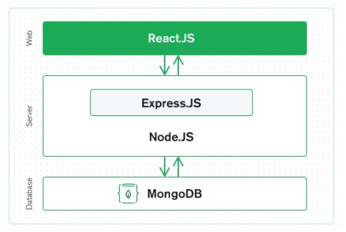
Technology tools
We’ll make use of the MERN stack.
M - MongoDB
E - Express
R - React (p5.js)
N - Node.js
(Audio analysis)

Slide 5
Milestones:
1
2
3
4
Tech Stack
Create 14 week plan
Plan use cases
Set up github
MERN + p5.js
Working prototype by week 6 ?
Add extra features
5
6
Set up IDE
Build back-end
Create database
Build REST API

